Slide 1




Smart Drought Response: AI Ranking for High‑Risk Counties
Team Geek Squad - Juwan Johnson, Karim Stackhouse, Joshua Parker, Carelle Ngadeu, Jeremiah Drummond

Slide 2




Problem Statement
() Traditional drought triggers like rainfall deficits often miss the counties experiencing real crop losses, slowing emergency relief decisions.
() We built a data‑driven county ranking and trigger system trained on 2000–2015 and validated on 2016–2025 to reliably identify high‑risk areas.
() Our GitHub Pages dashboard gives state officials a fast, clear way to target drought assistance with greater accuracy and confidence.
Notes:
Droughts and their triggers, such as rainfall deficits, cause crop losses in some counties. Emergency relief takes a long time to be processed due to outdated systems.
To address this, we built a dashboard that lets drought relief coordinators identify high-risk areas using 2000-2015 data.
We displayed our dashboard using GitHub Pages, which will give state officials a fast and clear way to provide accurate drought assistance

Slide 3


State Drought Program officials must decide...
() Which counties should receive funding first
() What metric or threshold triggers assistance
() Which counties face the most urgent drought-related losses
Notes:
The decisions drought program officials must make are:
Which counties should get funding first?
What metric or threshold triggers assistance?
Which counties face the most urgent losses related to droughts.

Slide 4

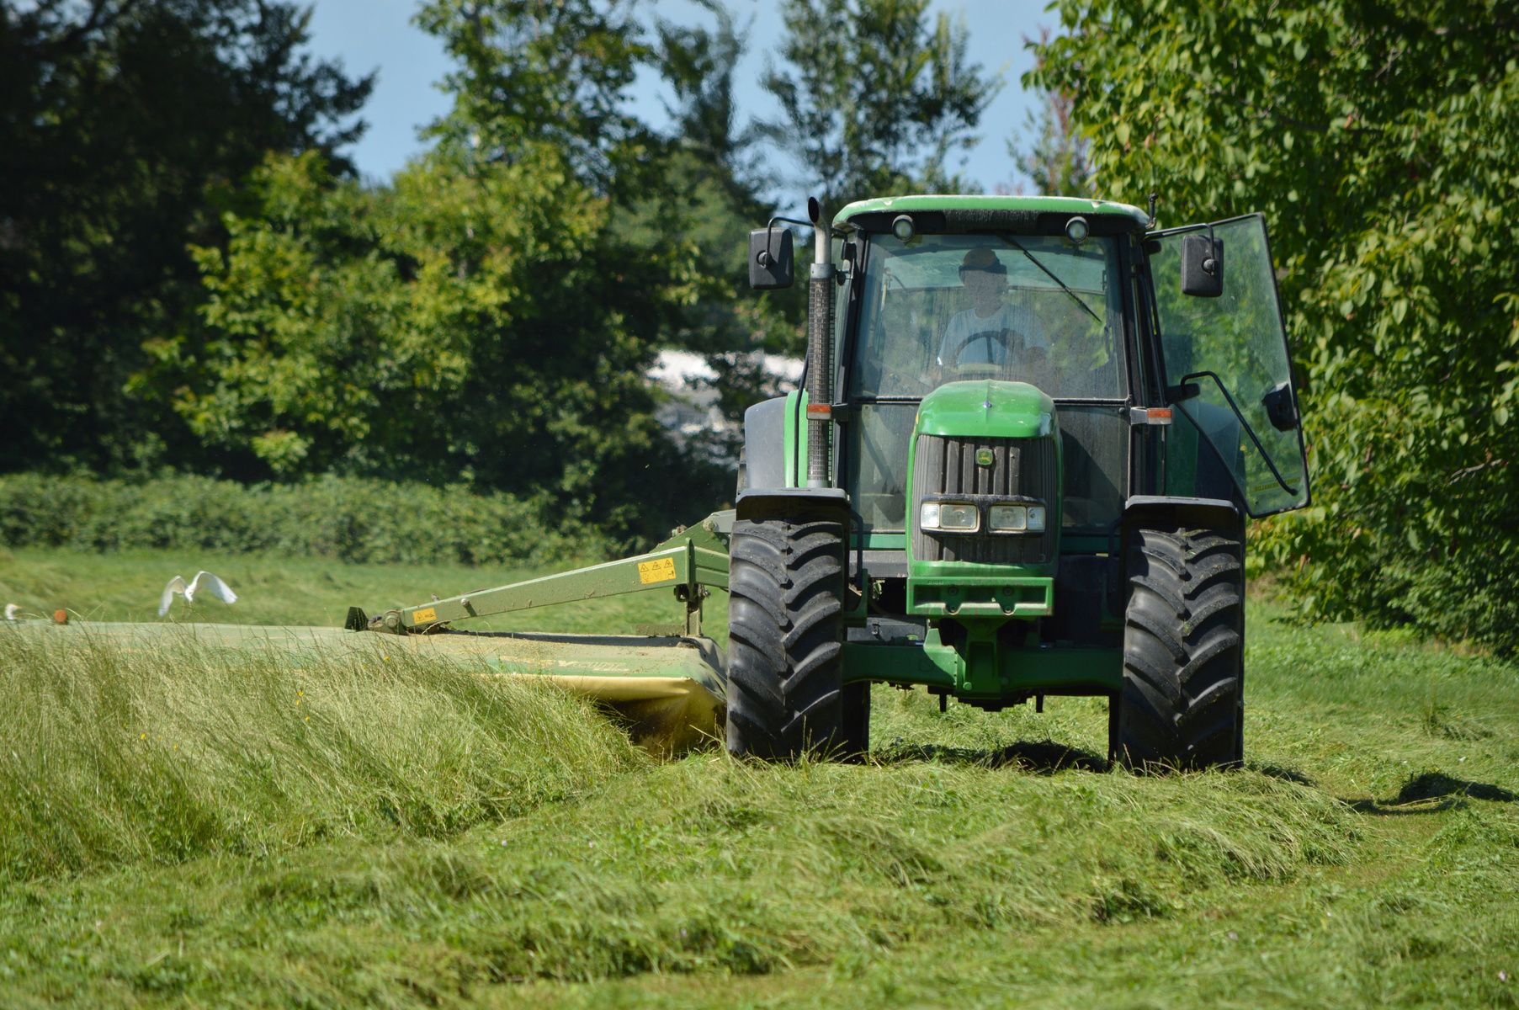
Success looks like...
Success Checkpoints:
() County report cards show historical drought conditions and crop yield losses
() A ranking model developed using 2000–2015 data identifies severe yield losses in unseen data from 2016–2025
Benefits:
() Rankings outperform simpler approaches, such as random allocation or prioritizing rainfall shortages alone
() An interactive dashboard lets officials explore county rankings, historical trends, and assistance thresholds
Notes:
Based on the needs of drought program officials, our success checkpoints are:
County report cards showing historical drought conditions and crop yield losses
Ranking model developed from 2000-2015 data that helps identify severe yield losses in unseen data from 2016-2015
These rankings outperform simpler approaches by giving a specific overview of the data compared to random allocation or rainfall shortage prioritization alone
The interactive dashboard will let officials see the rankings, but also historical trends and set thresholds for assistance

Slide 5
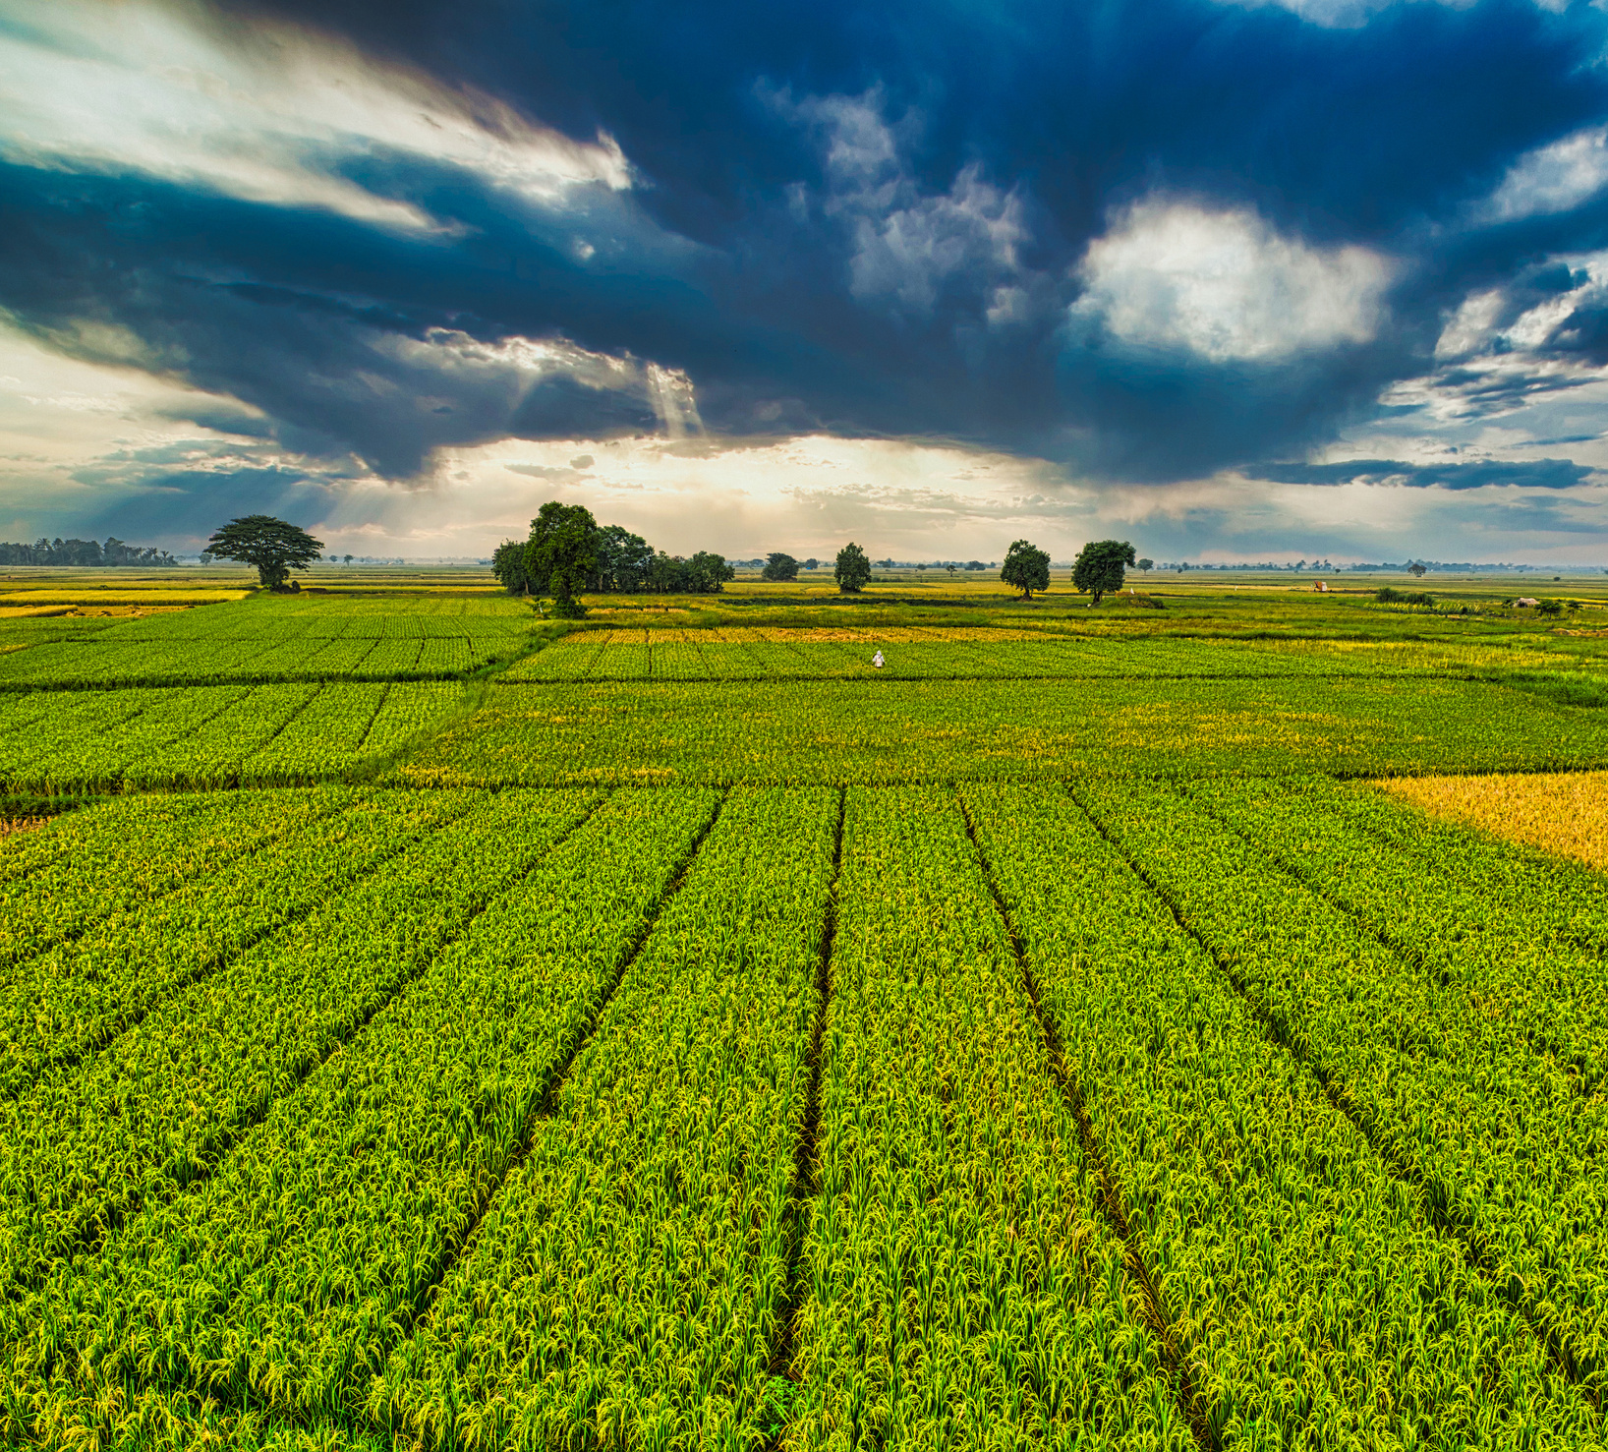
Ex. User : Dana Mitchell
State Drought Relief Coordinator
() Works for a state agricultural agency and coordinates emergency drought assistance
() Has a limited relief budget and needs to decide which counties receive funding first
() Must explain funding recommendations to agency leadership and county agricultural offices
() Needs clear evidence and an easy-to-use dashboard—not a tool that requires coding
Notes:
Our specific user is Dana Mitchell, a state drought relief coordinator.
She works for a state agricultural agency and is responsible for coordinating emergency drought assistance.
However, her budget is limited.
Dana needs to explain her funding recommendations, so her evidence must be clear and easy to present, without requiring any coding skills.

Slide 6

Demo
https://ms-cc-org.github.io/DSU-Hackathon-2026-Geek-Squad/

Slide 7
Thank You!
Questions?

